Slide 1
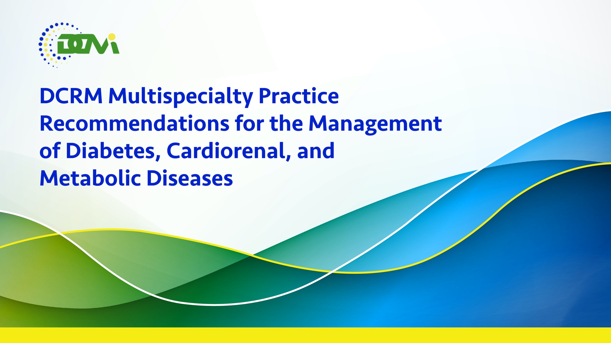

Slide 2
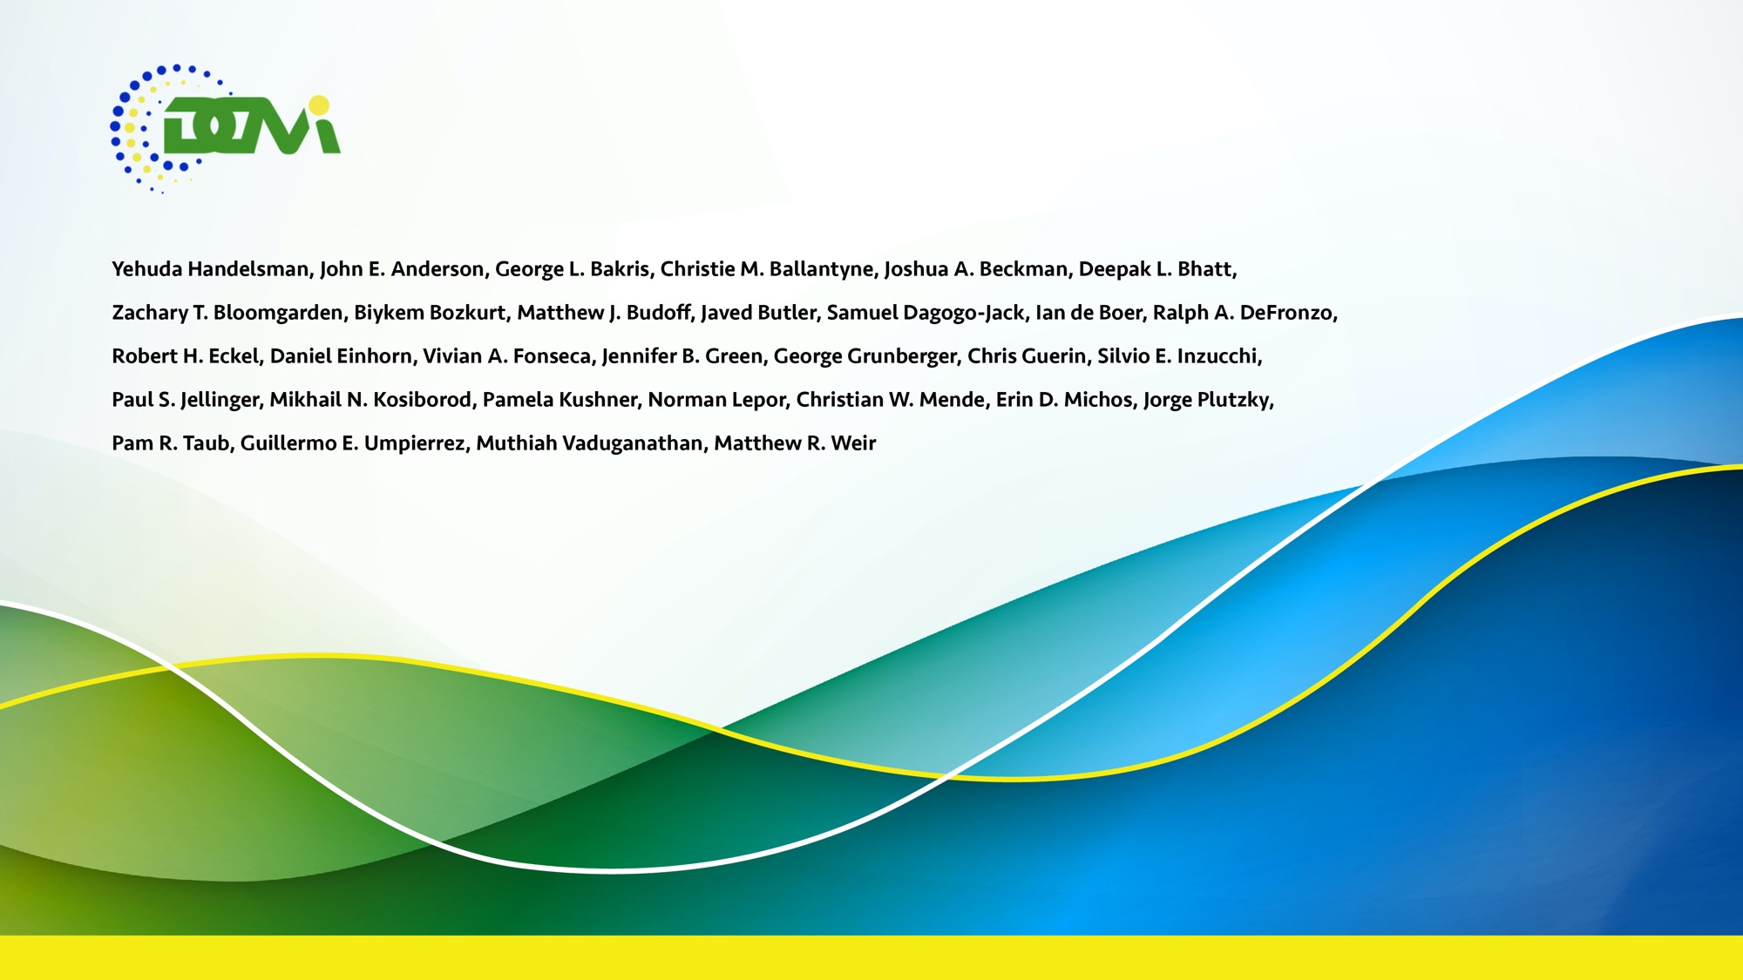

Slide 3
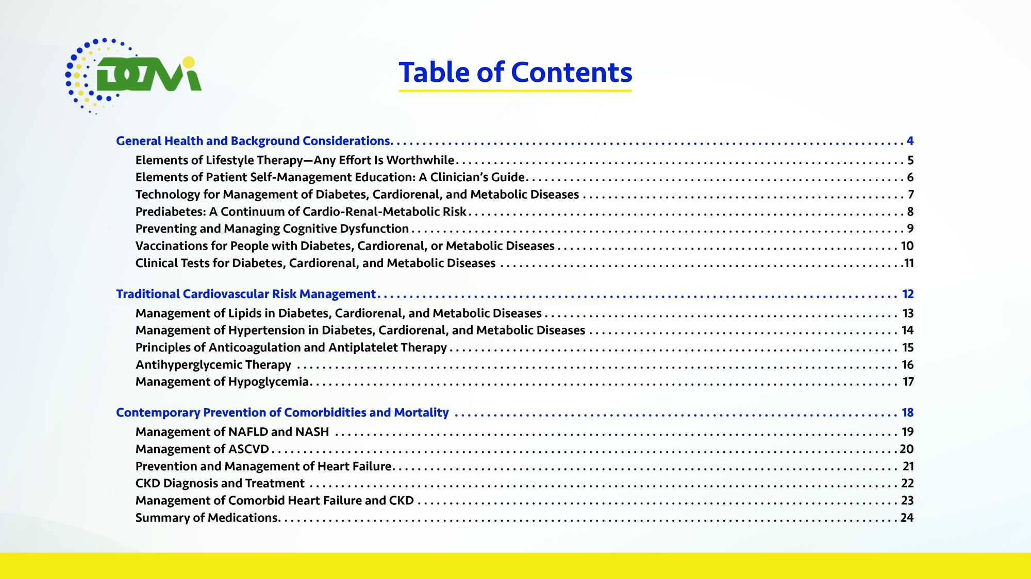

Slide 4


Slide 5
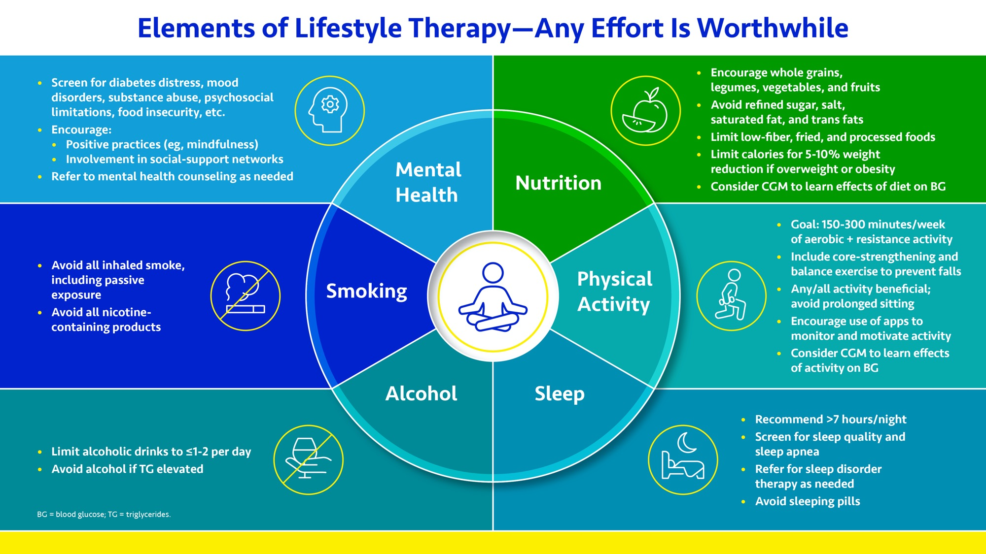

Slide 6
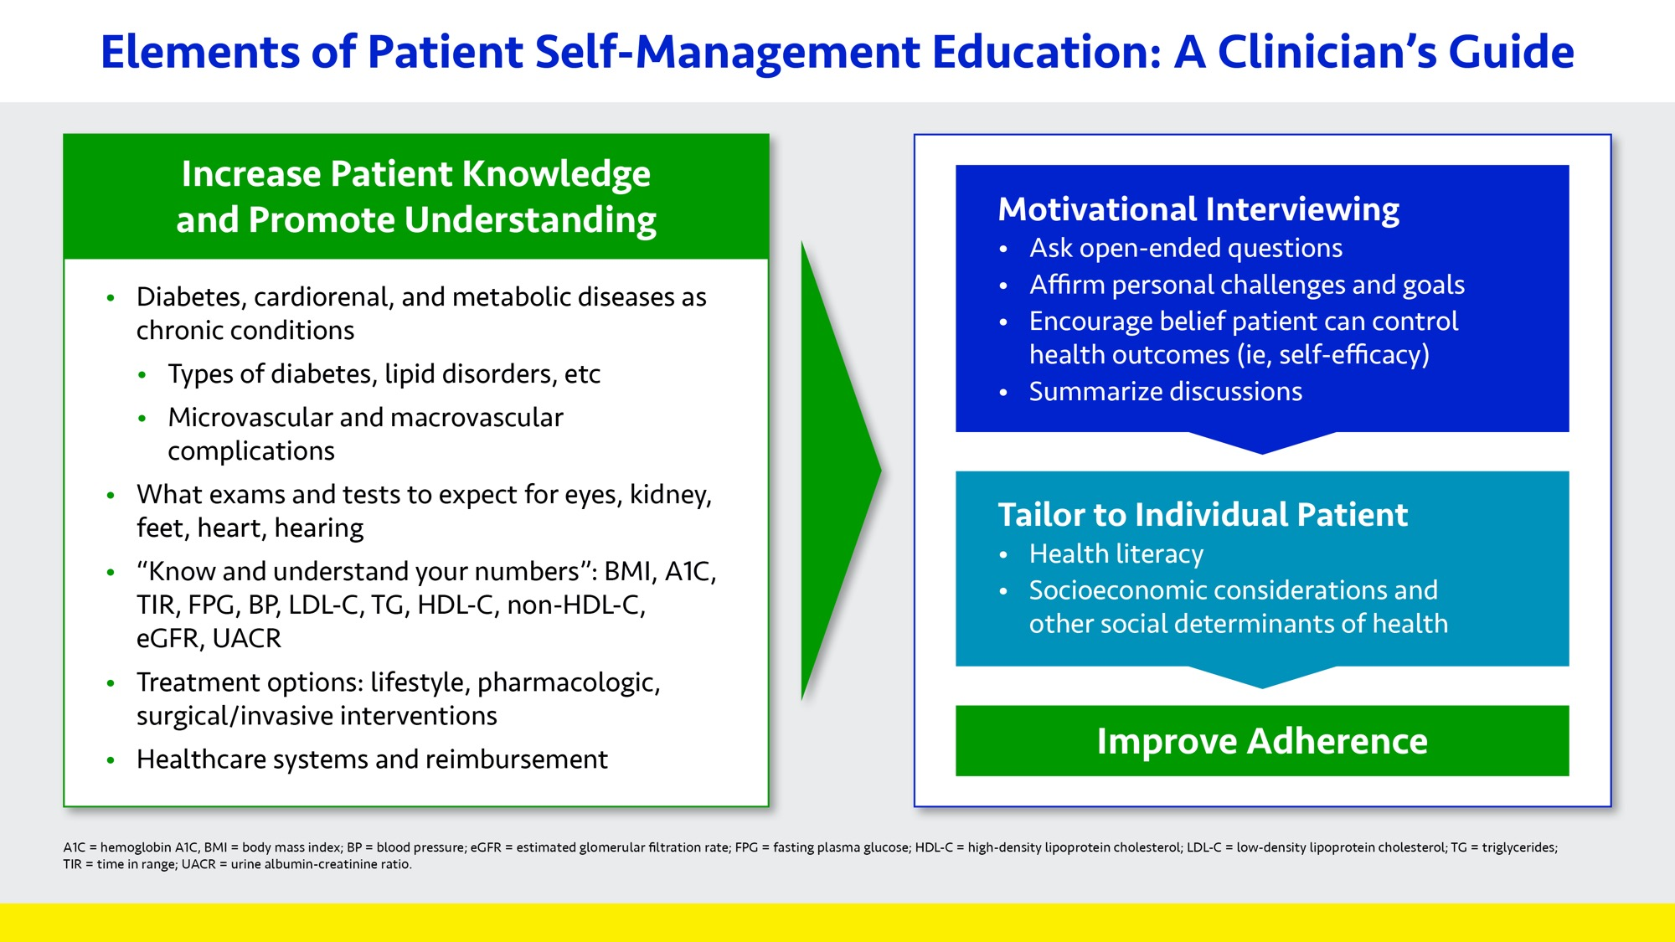

Slide 7
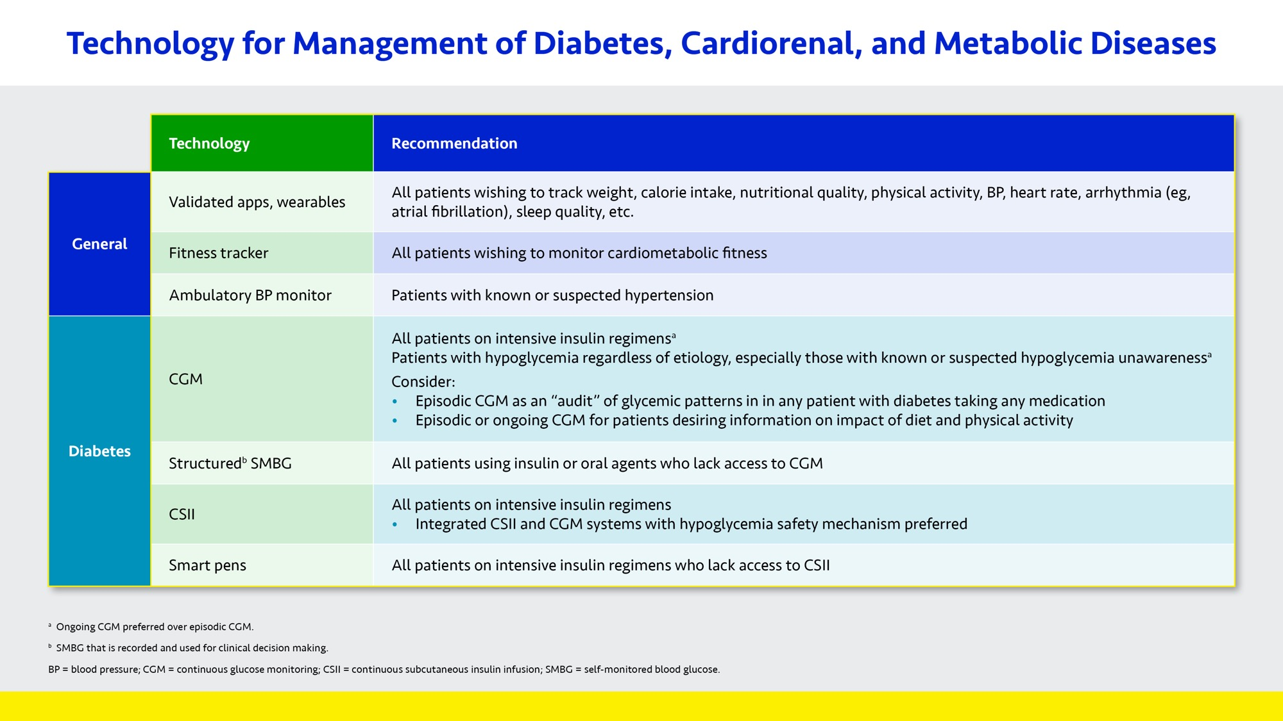

Slide 8
Prediabetes: A Continuum of Cardio-Renal-Metabolic Risk
Prediabetes Glucose Ranges
All at CKD and CVD Risk
Lifestyle Intervention for All
CVD therapies Weight loss therapies Antihyperglycemic therapies
<126 .<200 <6.5%
IFG and IGT IFG or IGT
Metabolic syndrome
High normal glycemia in
at-risk persons
All patients with prediabetes are at risk of CKD, ASCVD, and HF
Risk of progression to T2D increases as prediabetes advances
FPG (mg/dL)
2-h PG (mg/dL)
A1Cª
T2D risk
CVD therapies
Weight loss therapies
Antihyperglycemic therapies
<100
<140
<5.7%
 | Prevent progression of hyperglycemia and CVD risk
 | Achieve normoglycemia with lifestyle and reduce CVD risk factors Even short-term regression to normal glucose tolerance with lifestyle may have durable benefits
As needed:
BP-reducing agents
Lipid-control agents^{b}
SGLT2is and GLP1-RAs^{c}
Other CVD therapies^{d}
Consider if:
5-10% weight loss not achieved with lifestyle alone
If hyperglycemia progresses:
Metformin
Low-dose Pio
SGLT2i
GLP1-RA
Acarbose
Goals
A1C = hemoglobin A1C; ASCVD = atherosclerotic cardiovascular disease; BP = blood pressure; CKD = chronic kidney disease;
CVD = cardiovascular disease; FPG = fasting plasma glucose; GLP1-RA = glucagon-like peptide 1 receptor agonists; HF = heart failure; IFG = impaired fasting glucose; IGT = impaired glucose tolerance; MRA = mineralcorticoid receptor agonist; PG = plasma glucose;
Pio = pioglitazone; SGLT2i = sodium glucose cotransporter 2 inhibitors; T2D = type 2 diabetes.
ª Caution with A1C diagnosis of prediabetes in African American, Latinx, and other ethnic groups.
^{b} CVD benefit from statins more important than potential A1C increases.
^{c} Trials with GLP1-RAs and SGLT2is ongoing.
^{d} Antiplatelet therapies, MRAs, Pio 30 mg, etc.

Slide 9
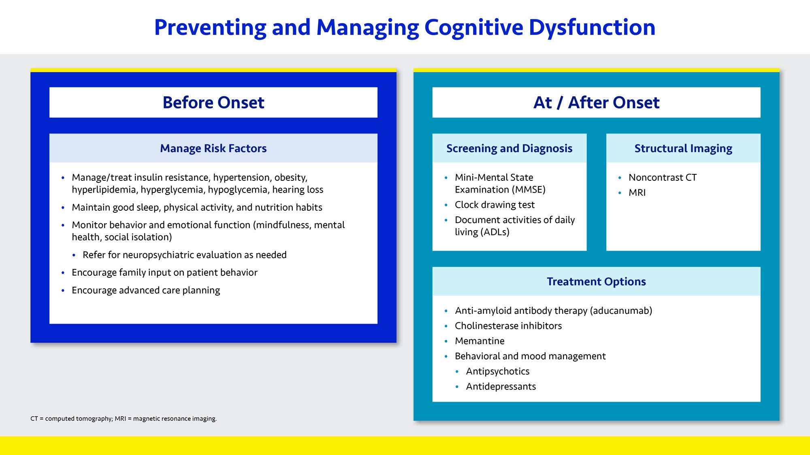

Slide 10
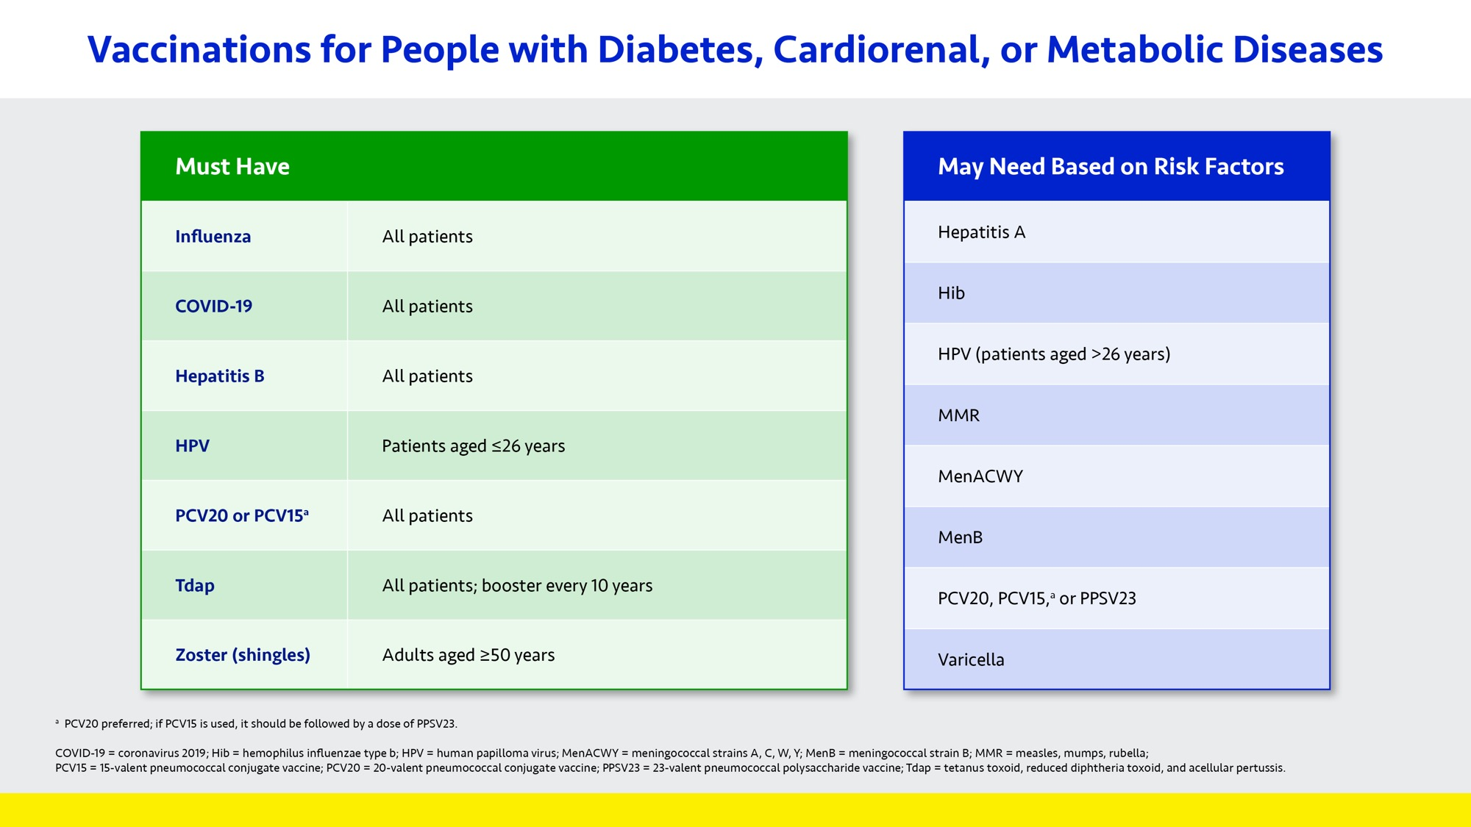

Slide 11
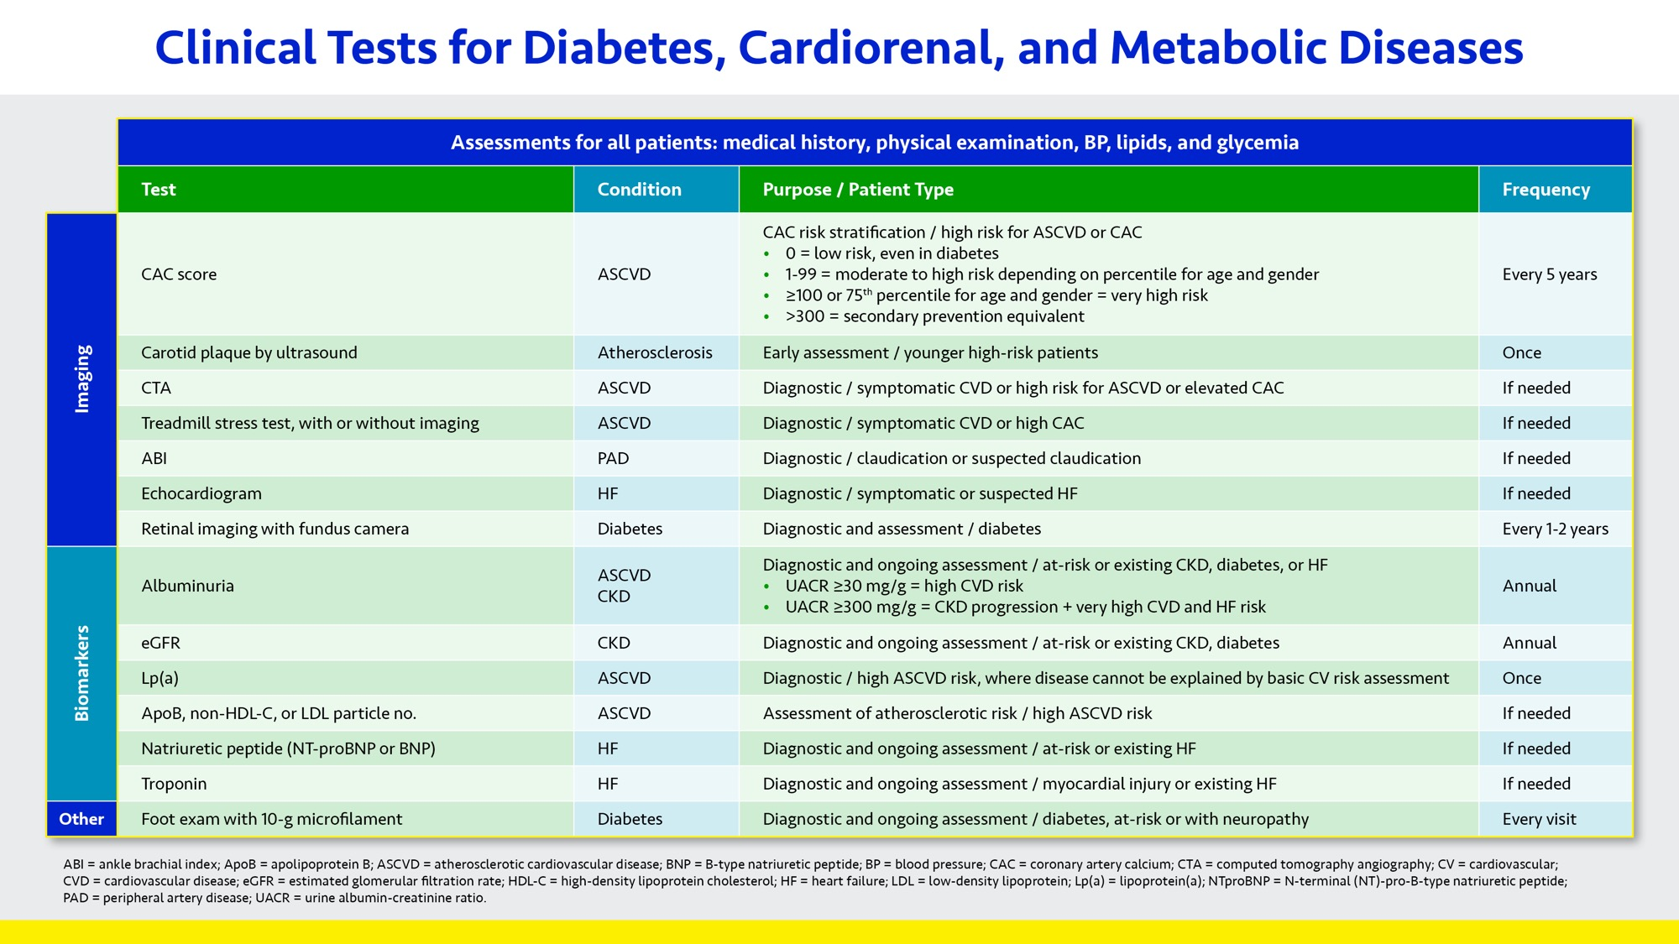

Slide 12


Slide 13
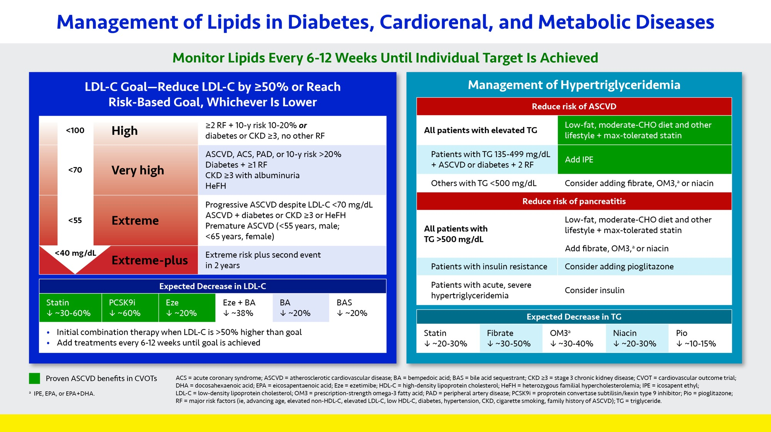

Slide 14
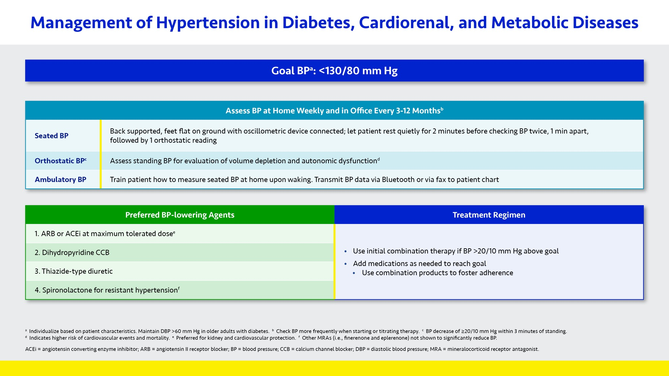

Slide 15
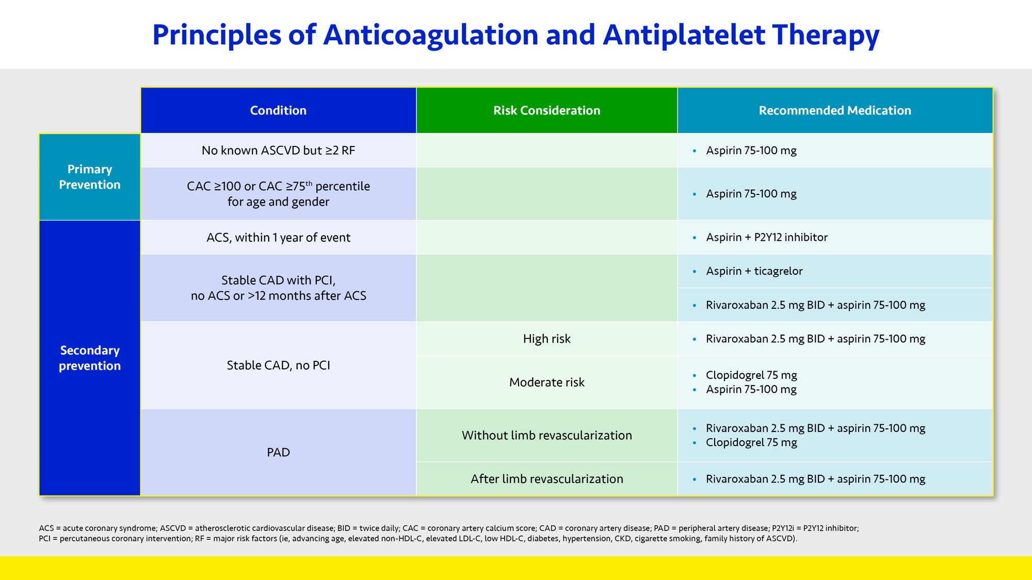

Slide 16
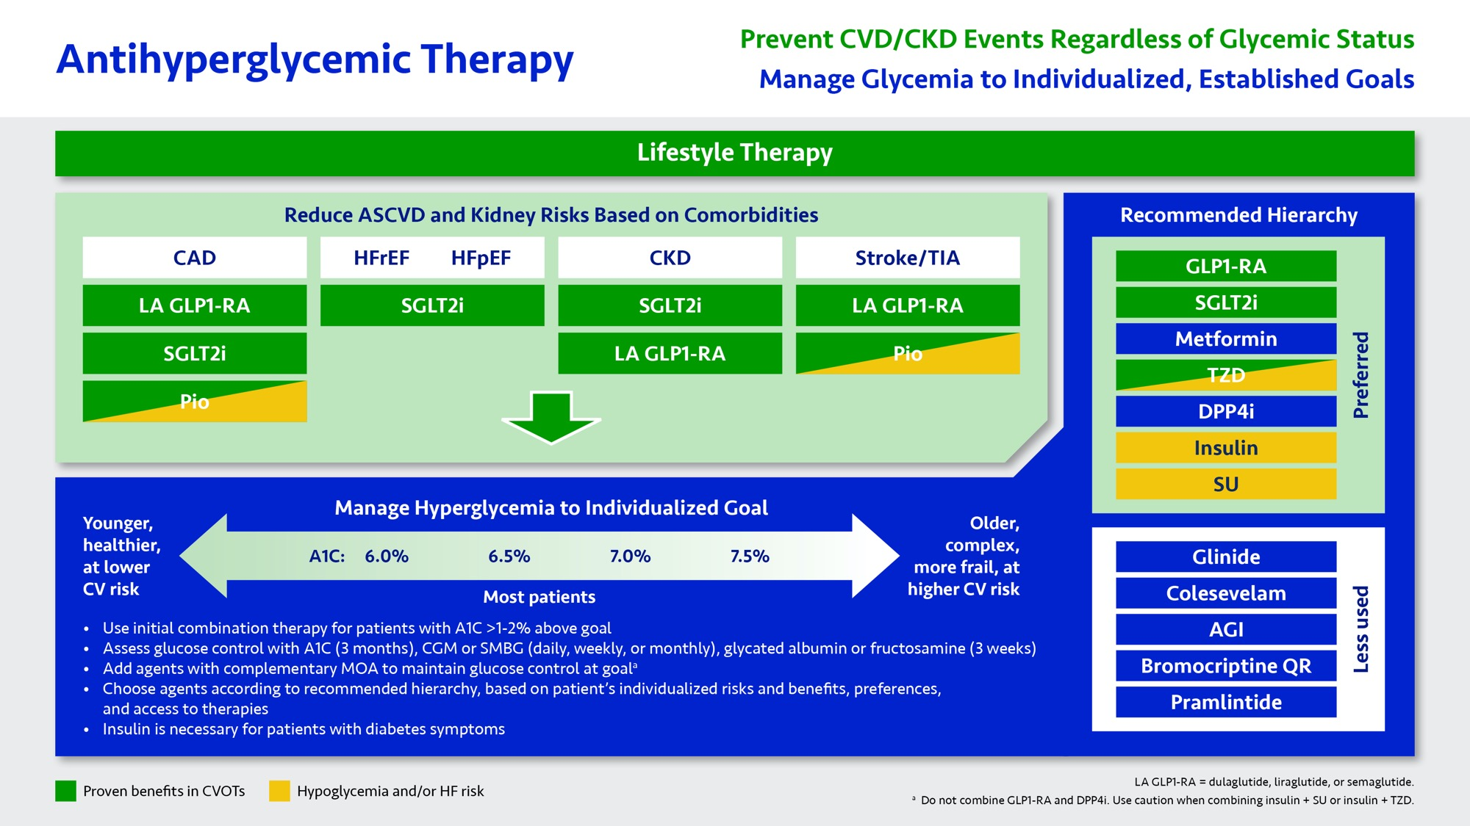

Slide 17
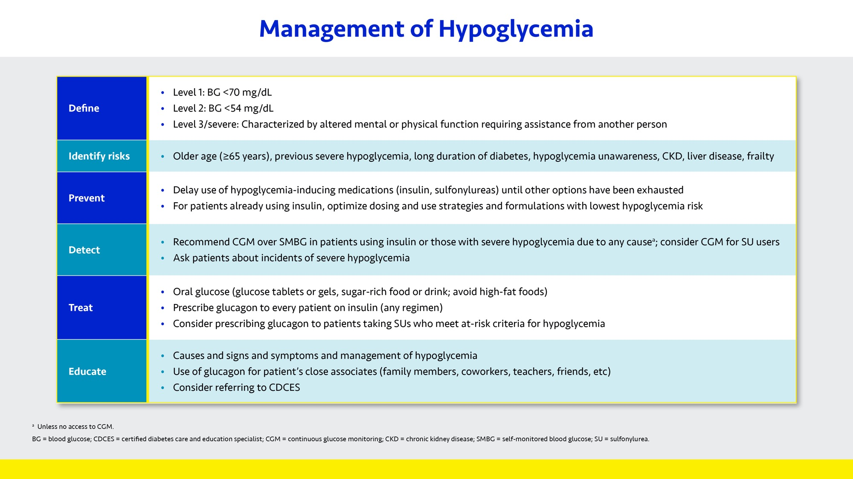

Slide 18
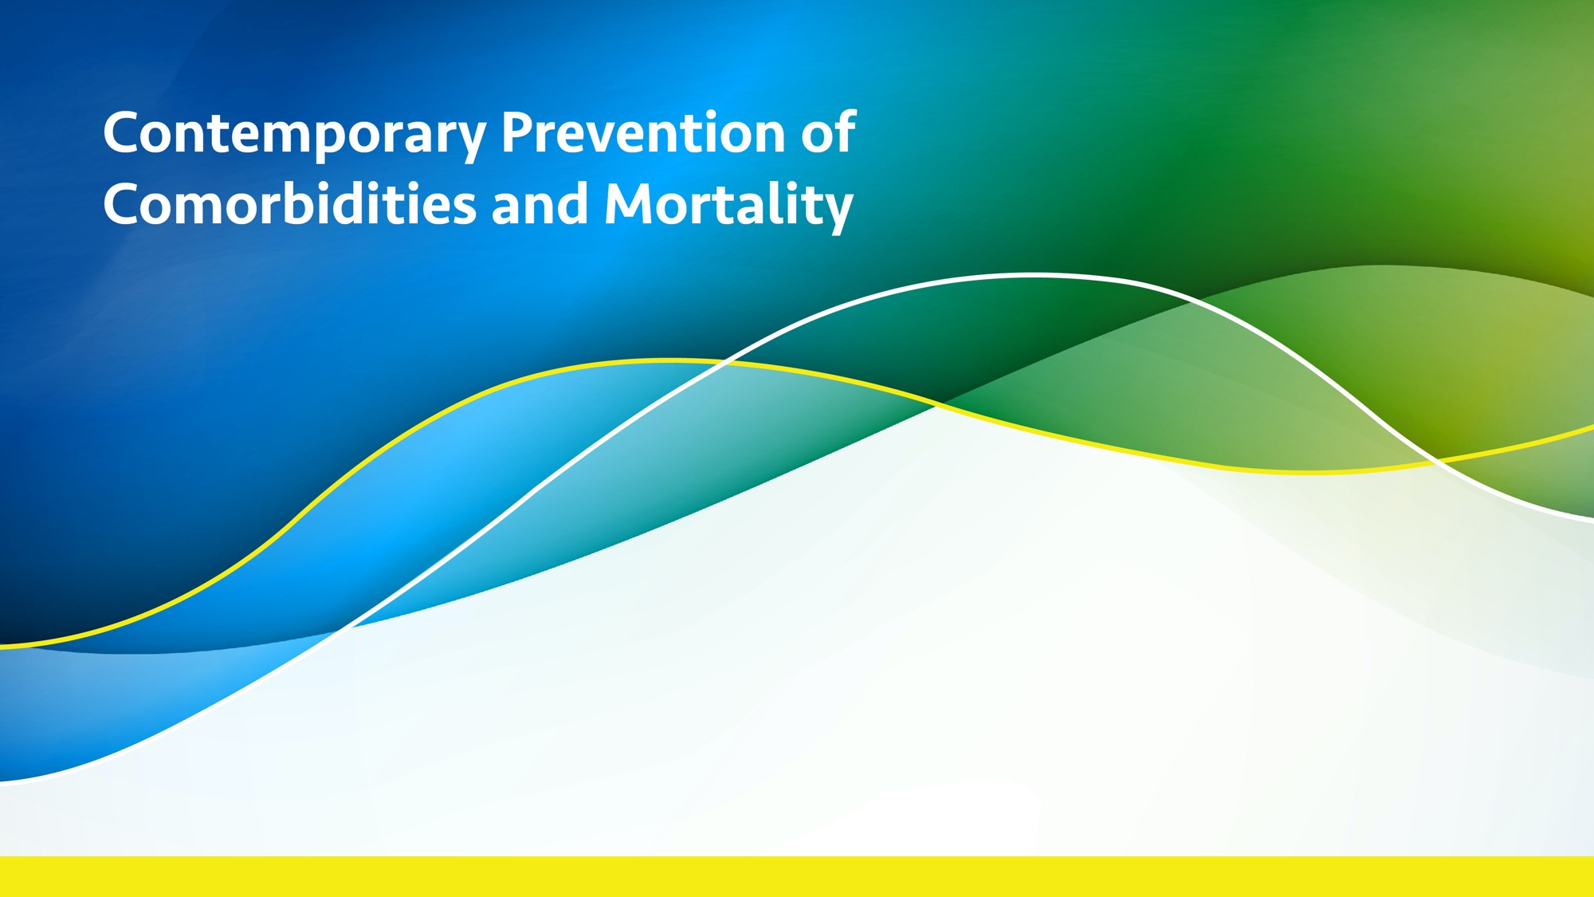

Slide 19
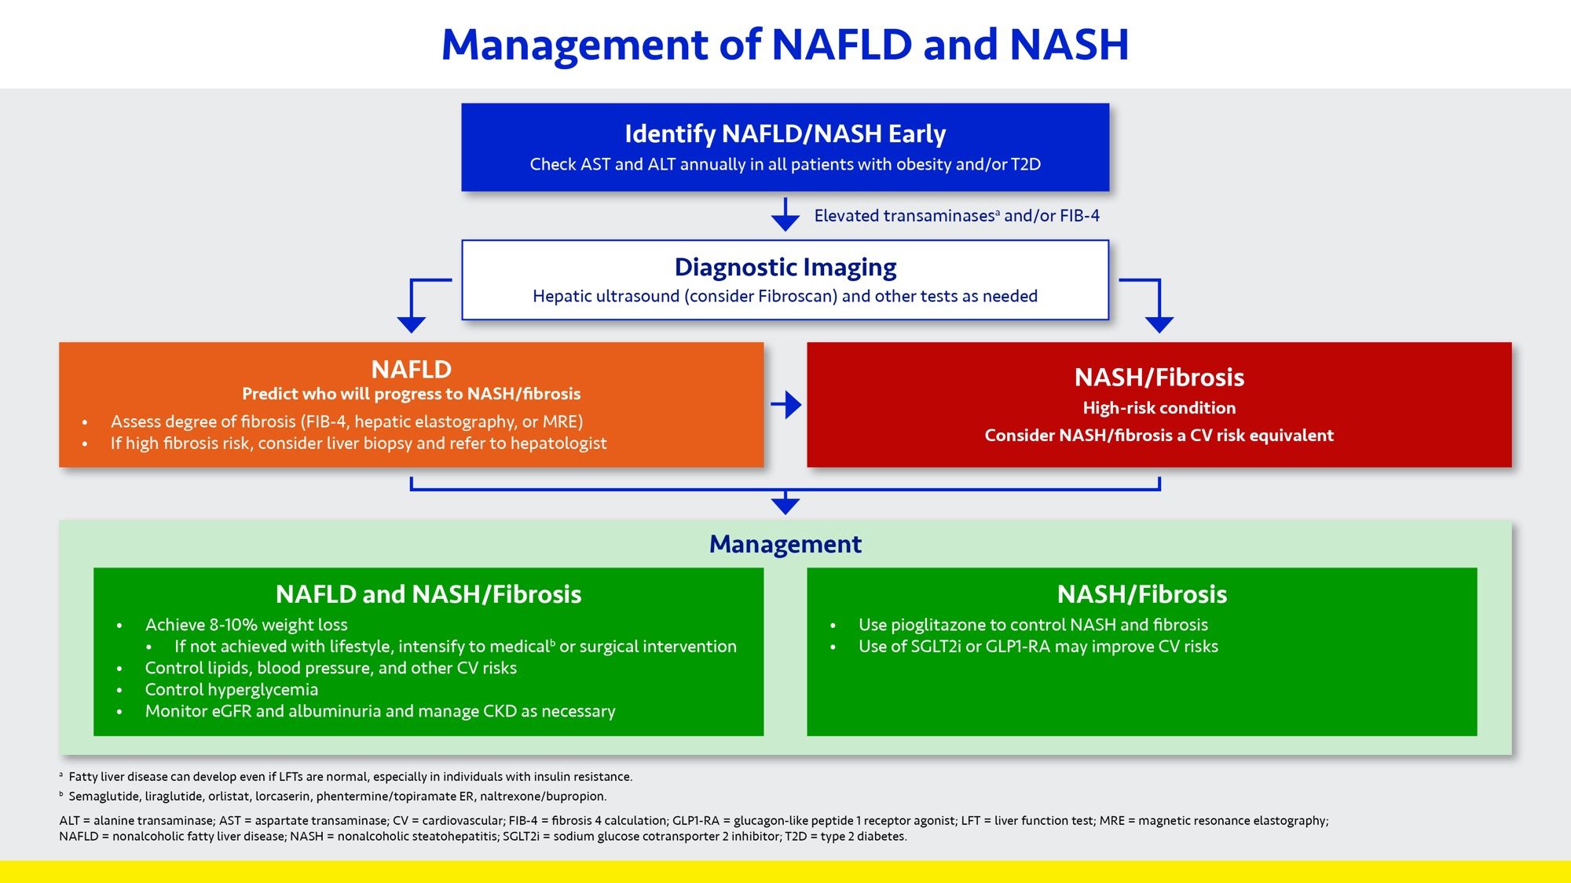

Slide 20
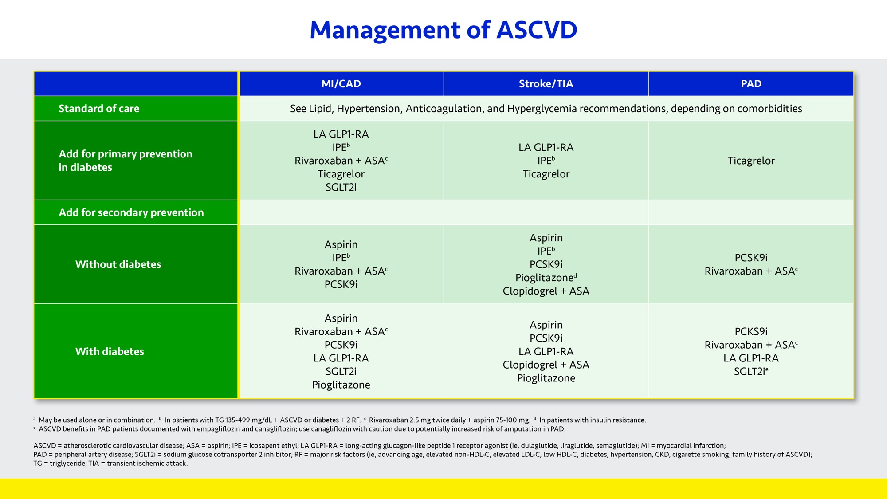

Slide 21
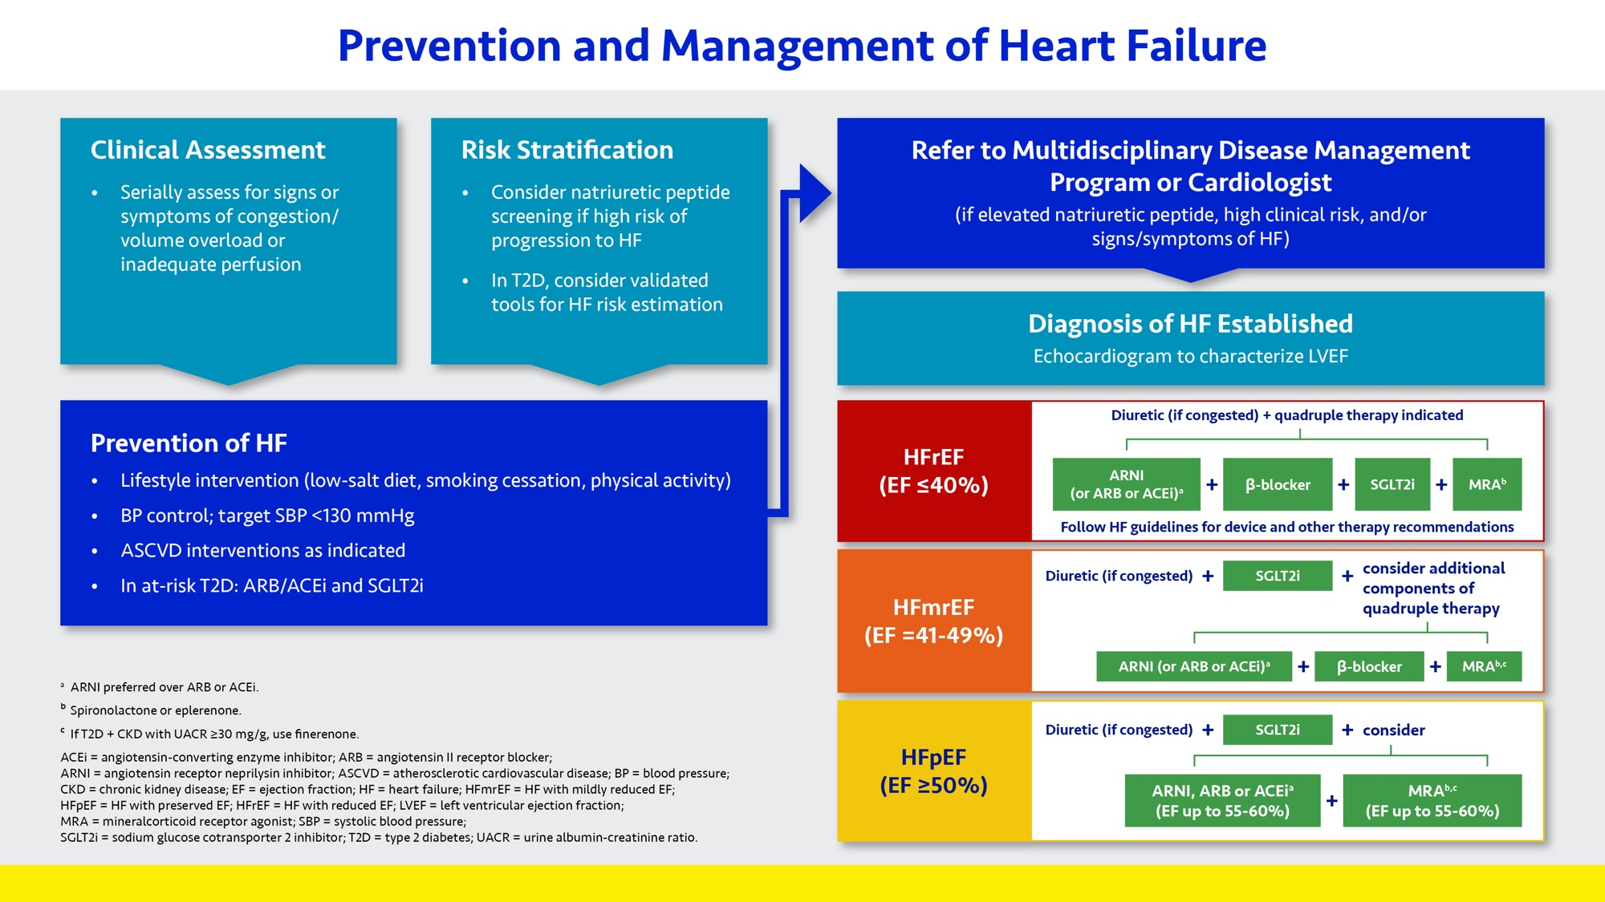

Slide 22
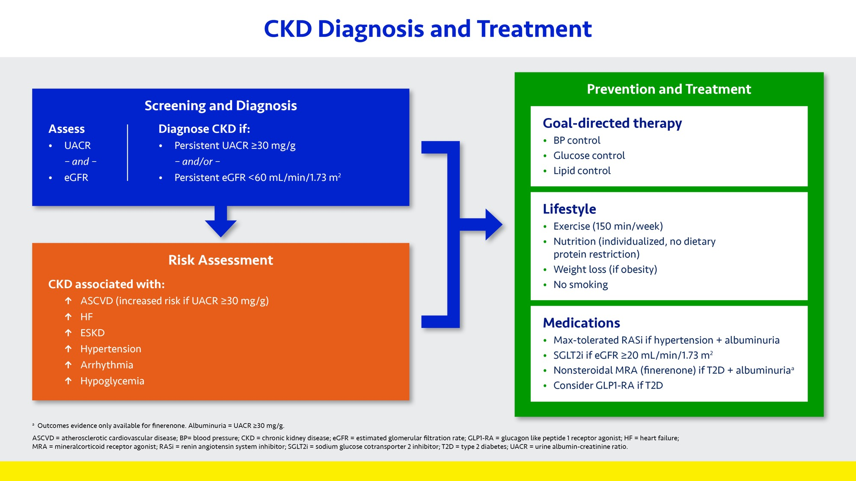

Slide 23
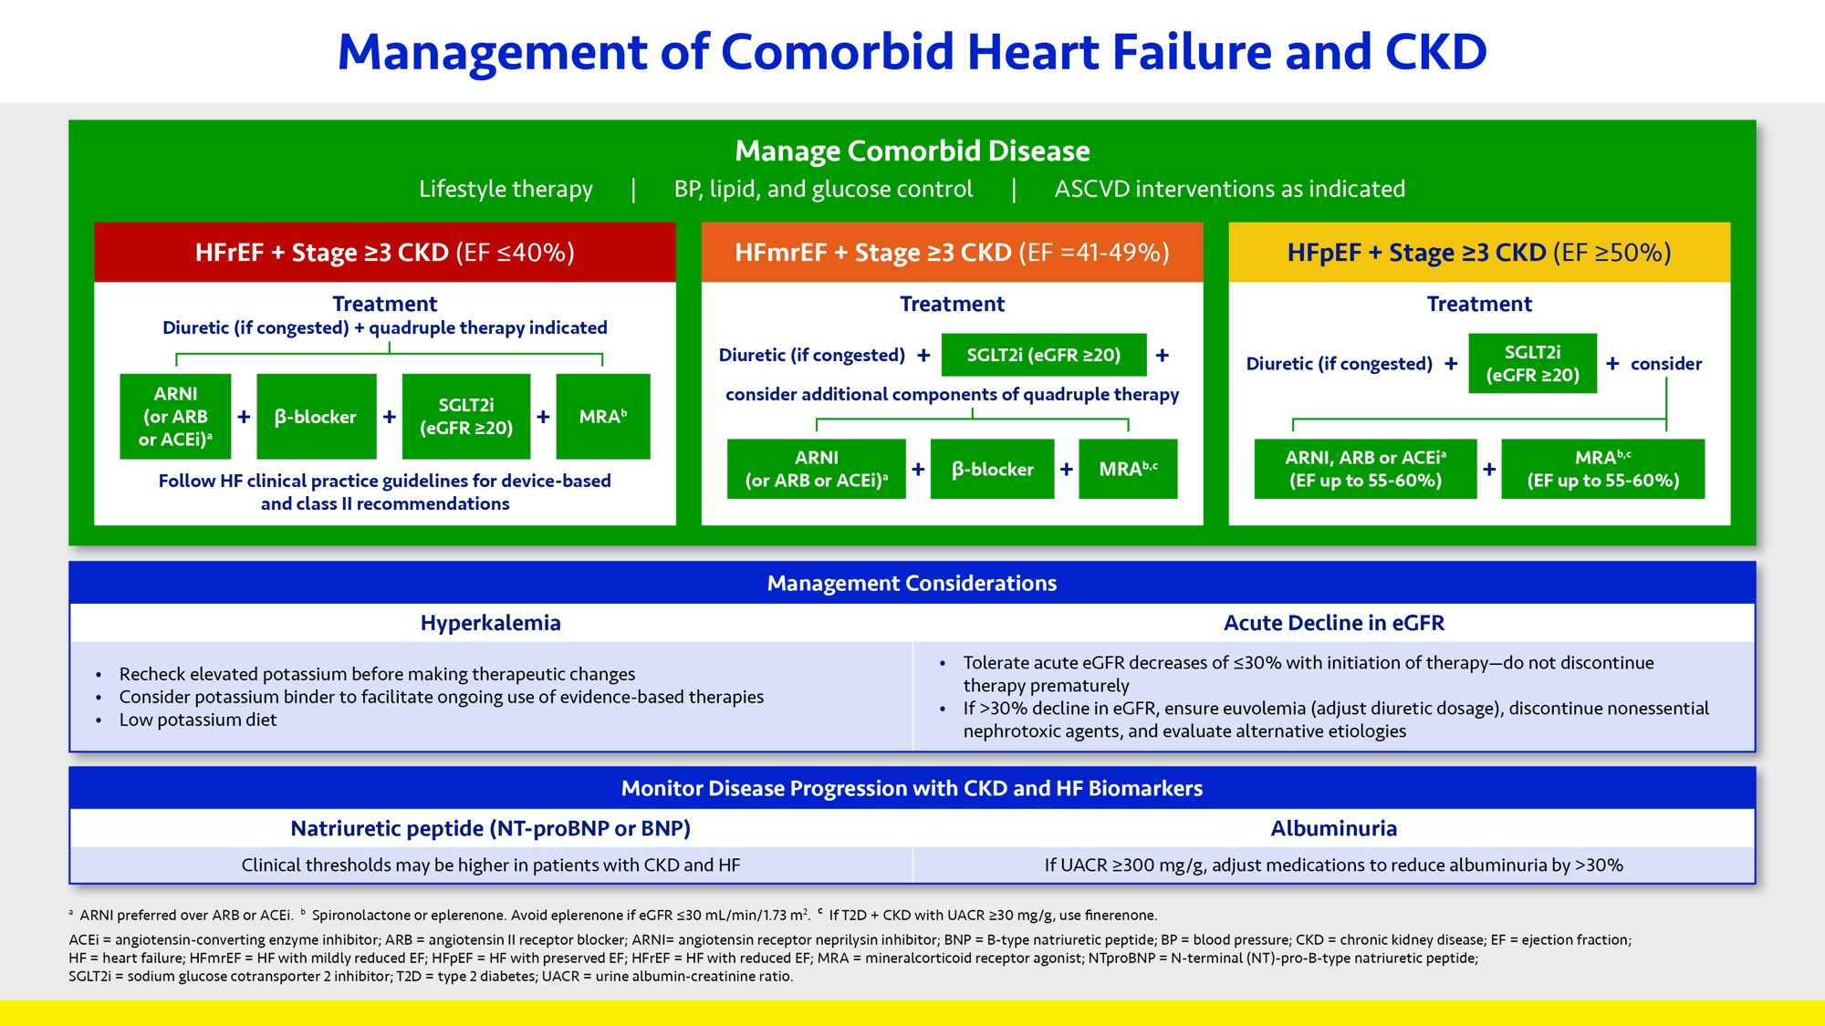

Slide 24
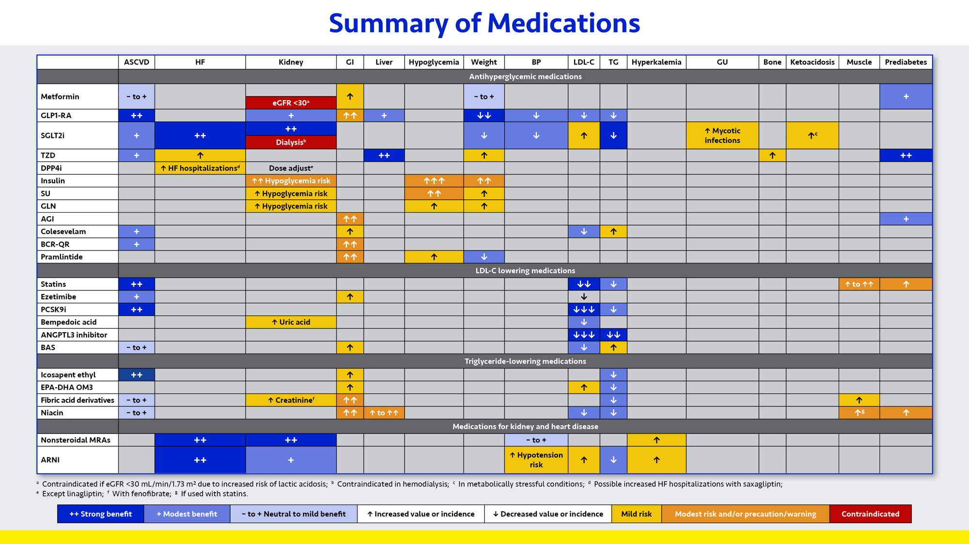

Slide 25
PUBLICATION - December 7, 2021
Journal of Diabetes and Its Complications journal homepage: www.elsevier.com/locate/jdiacomp
DCRM Multispecialty Practice Recommendations for the management of diabetes, cardiorenal, and metabolic diseases
Yehuda Handelsman a,*, John E. Anderson b, George L. Bakris c, Christie M. Ballantyne d, Joshua A. Beckman e, Deepak L. Bhatt f, Zachary T. Bloomgarden g, Biykem Bozkurt d, Matthew J. Budoff h, Javed Butler i, Samuel Dagogo-Jack j, Ian H. de Boer k, Ralph A. DeFronzo l,Robert H. Eckel m, Daniel Einhorn n, Vivian A. Fonseca o, Jennifer B. Green p, George Grunberger q, Chris Guerin r, Silvio E. Inzucchi s, Paul S. Jellinger t, Mikhail N. Kosiborod u, Pamela Kushner v, Norman Lepor h, Christian W. Mende r,
Erin D. Michos w, Jorge Plutzky f, Pam R. Taub r, Guillermo E. Umpierrez x, Muthiah Vaduganathan f, Matthew R. Weir y
a Metabolic Institute of America, Tarzana, CA, USA b The Frist Clinic, Nashville, TN, USA c University of Chicago Medicine, Chicago, IL, USA d Baylor College of Medicine, Houston, TX, USA e Vanderbilt University Medical Center, Nashville, TN, USA f Brigham and Women's Hospital, Harvard Medical School, Boston, MA, USA g Mount Sinai School of Medicine, New York, NY, USA h David Geffen School of Medicine, UCLA, Los Angeles, CA, USA i University of Mississippi Medical Center, Jackson, MS, USA j University of Tennessee Health Science Center, Memphis, TN, USA k University of Washington, Seattle, WA, USA l University of Texas Health Science Center, San Antonio, TX, USA m University of Colorado Anschutz Medical Campus, Denver, CO, USA n Scripps Whittier Institute for Diabetes, San Diego, CA, USA o Tulane University Health Sciences Center, New Orleans, LA, USA p Duke University Medical Center, Durham, NC, USA q Grunberger Diabetes Institute, Bloomfield Hills, MI, USA, Wayne State University School of Medicine, Detroit, MI, USA, Oakland University William Beaumont School of Medicine, Rochester, MI, USA, Charles University, Prague, Czech Republic r University of California San Diego School of Medicine, San Diego, CA, USA s Yale School of Medicine, New Haven, CT, USA t The Center for Diabetes & Endocrine Care, University of Miami Miller School of Medicine, Hollywood, FL, USA u Saint Luke's Mid America Heart Institute, University of Missouri–Kansas City, Kansas City, MO, USA v University of California at Irvine, Irvine, CA, USA
w Johns Hopkins University School of Medicine, Baltimore, MD, USA x Emory University, Atlanta, GA, USA y University of Maryland School of Medicine, Baltimore, MD, USA
https://linkinghub.elsevier.com/retrieve/pii/S1056872721003251
Journal of Diabetes and Its Complications 36 (2022) 108101 doi: 10.1016/j.jdiacomp.2021.108101.PMID: 34922811

Slide 26

Free Download- The Publication
https://www.sciencedirect.com/science/article/pii/S1056872721003251
Free Download- The Slide deck
https://www.dcrmi.com/dcrm-practice-recommendations

